Slide 1



ATLIQ TECHNOLOGIES
WAVECON Telecom
Analysis
PRSENTED BY ANIRUDDHA BISWAS

Slide 2
WAVECON

Slide 3
WAVECON
Wavecon is the fastest-growing telecom company in India, renowned for its cutting-edge technology and expansive network. It recently launched its 5G services, setting a new standard in ultra-fast internet connectivity across the nation. Committed to innovation and quality, Wavecon is dedicated to enhancing the digital experience for all its customers, making it a leading force in India's telecommunications sector. Currently, it operates in 15 Indian cities.

Slide 4
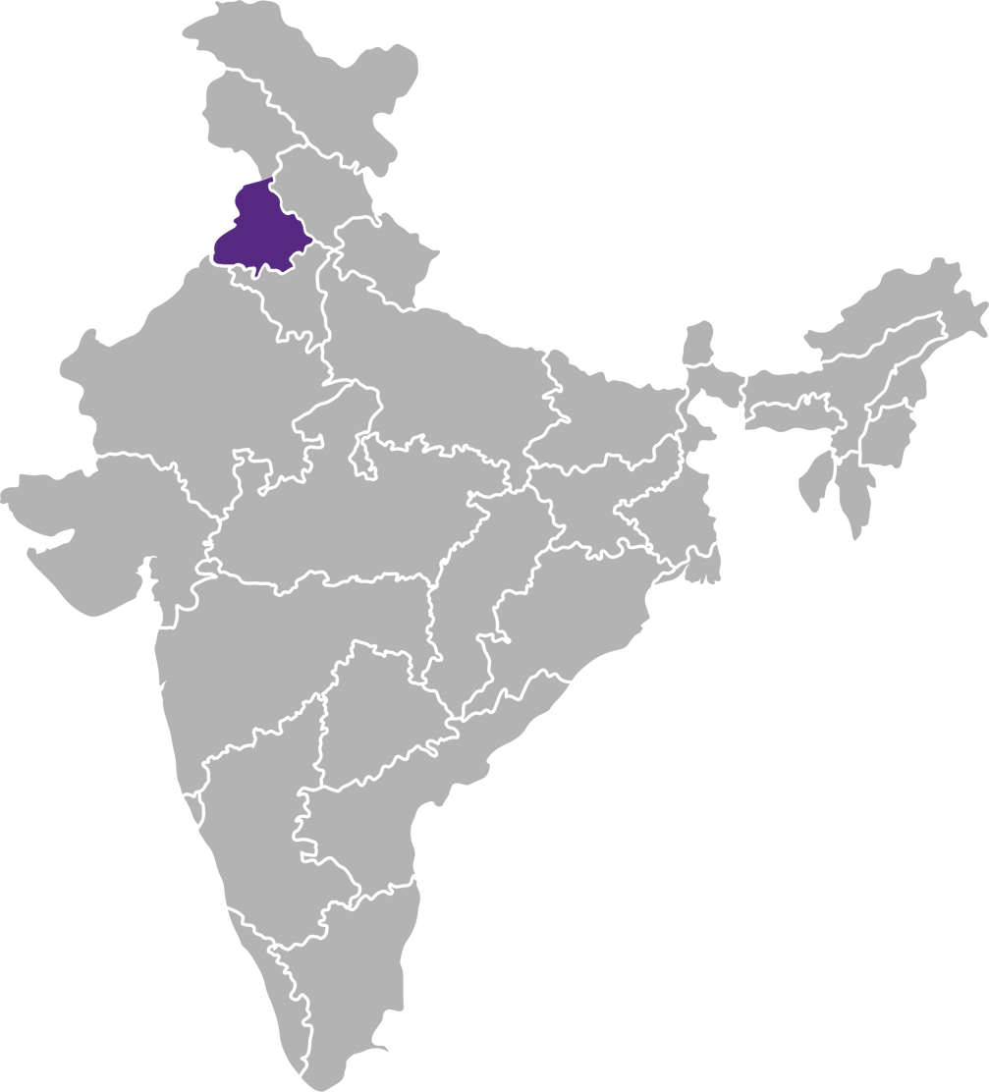

WAVECON
CHANDIGARH

Slide 5
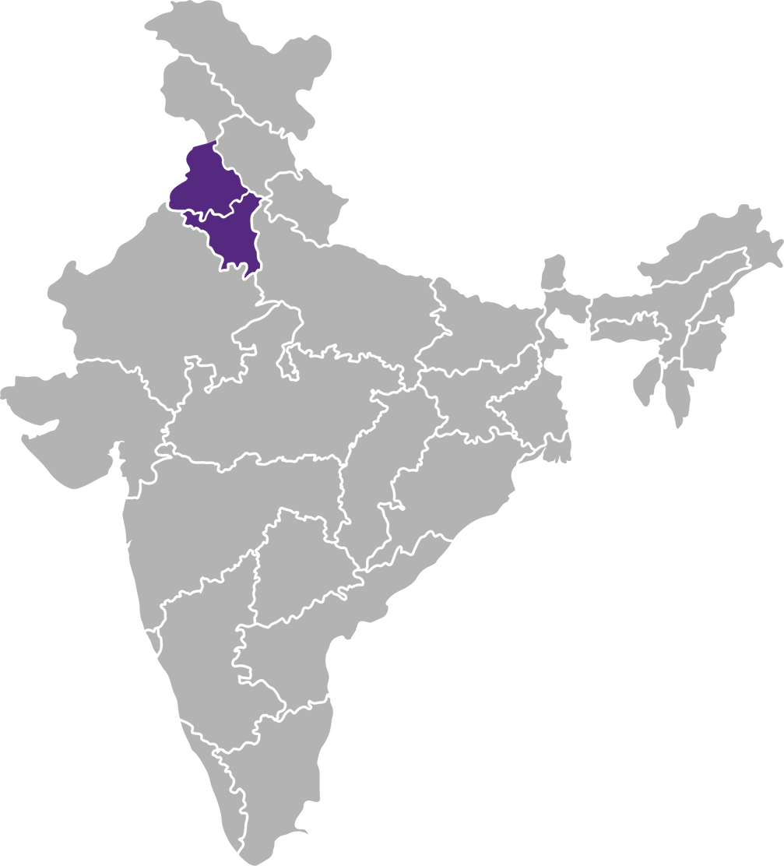
WAVECON
CHANDIGARH
DELHI
GURGAON

Slide 6
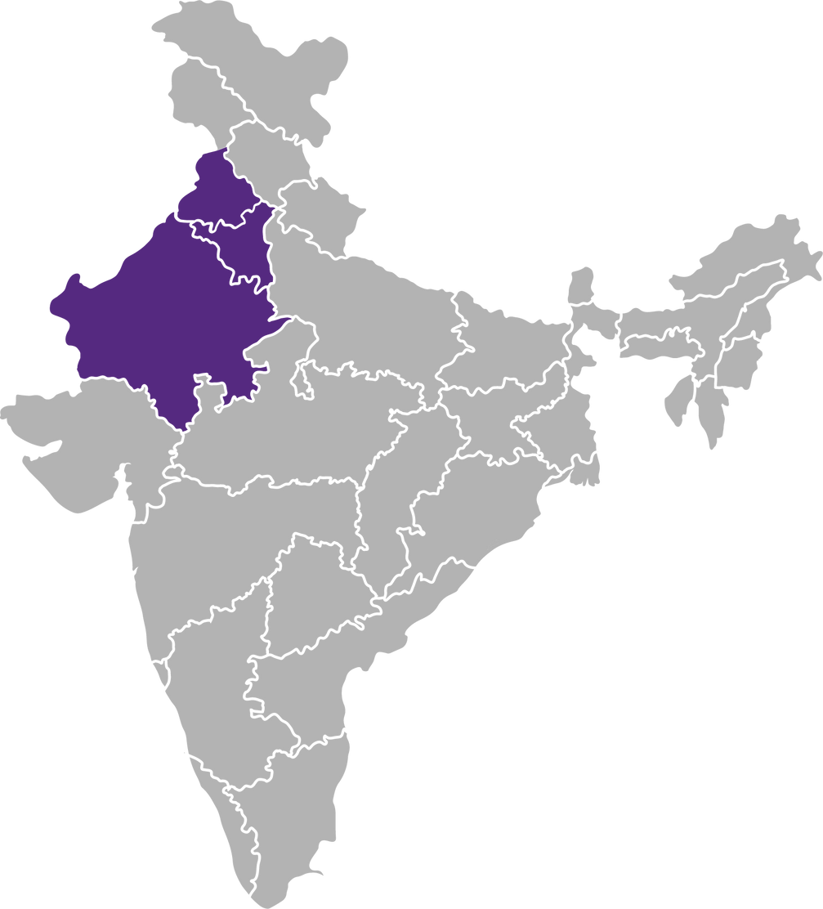
WAVECON
CHANDIGARH
DELHI
GURGAON
JAIPUR

Slide 7
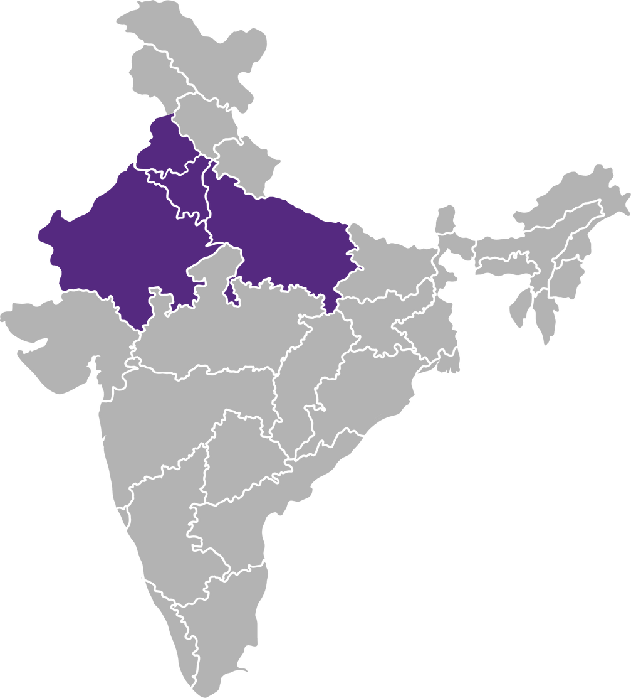
WAVECON
CHANDIGARH
DELHI
GURGAON
JAIPUR
LUCKNOW

Slide 8
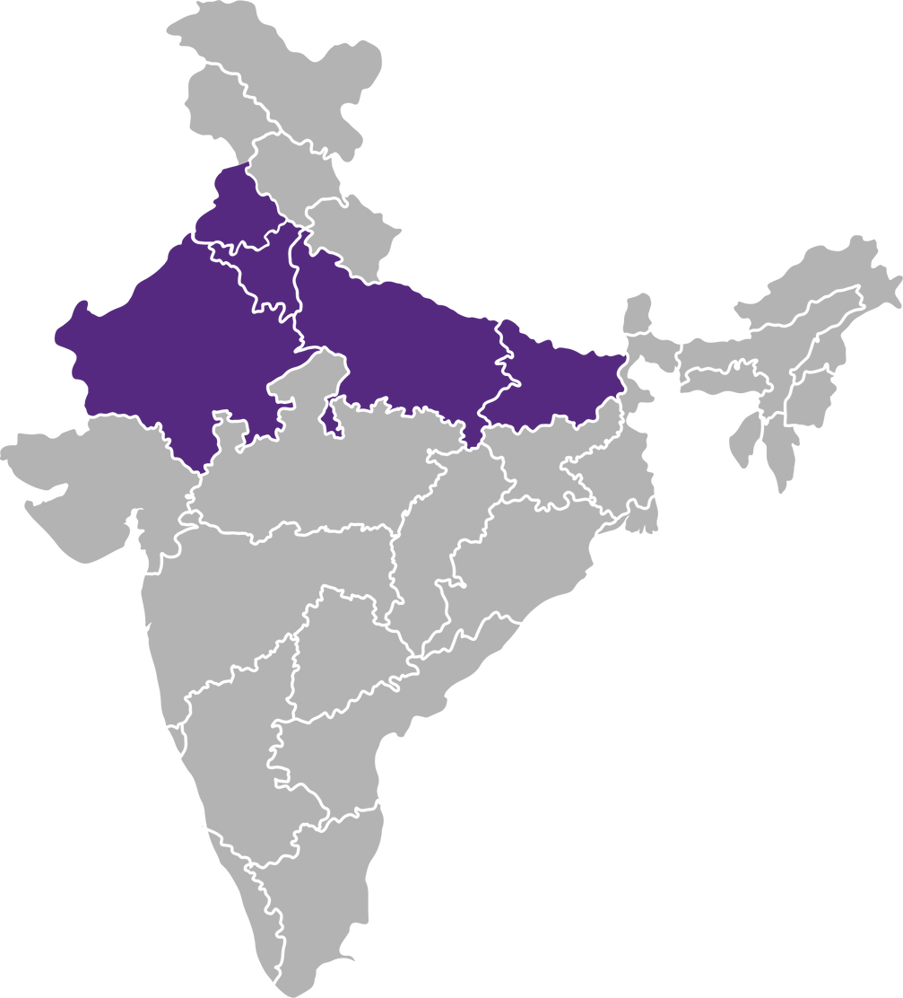
WAVECON
CHANDIGARH
DELHI
GURGAON
JAIPUR
LUCKNOW
PATNA

Slide 9
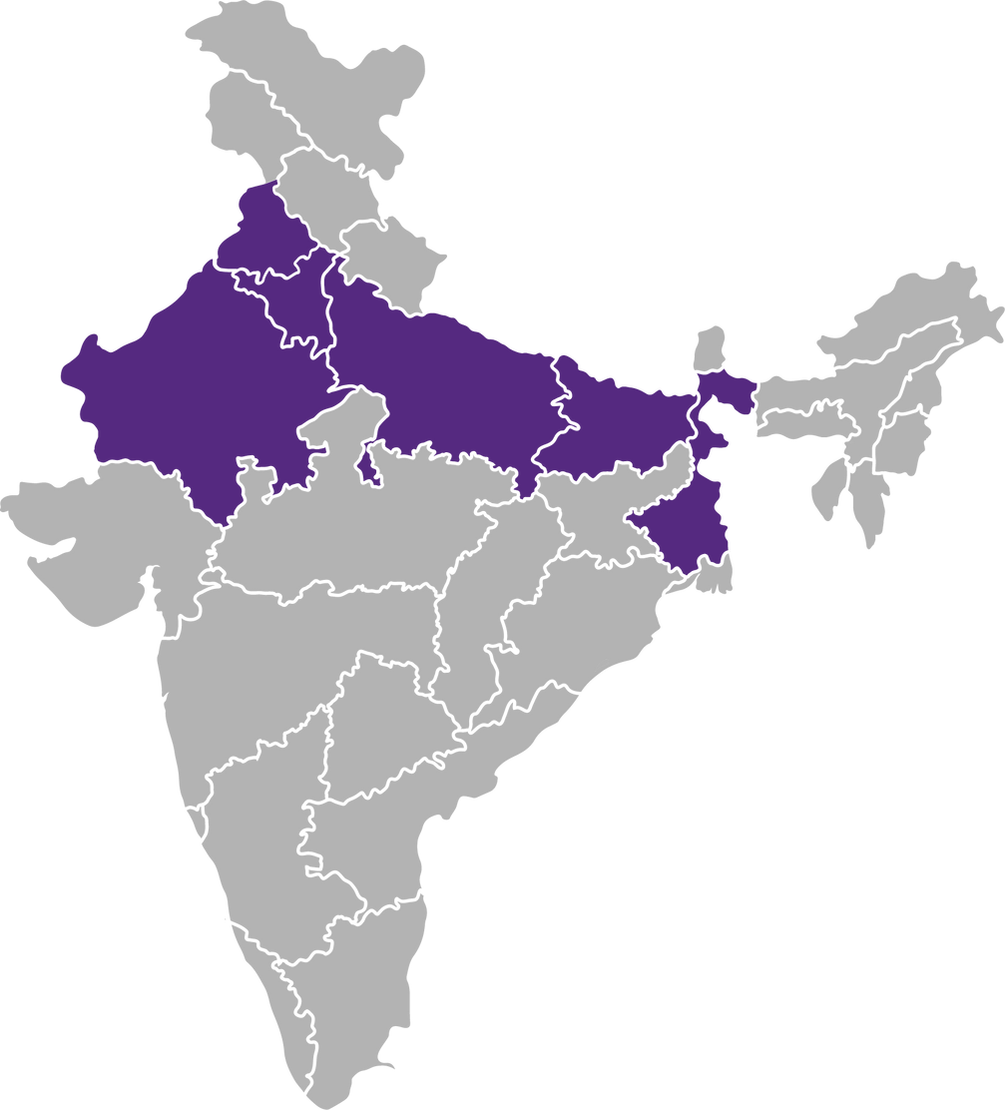
WAVECON
CHANDIGARH
DELHI
GURGAON
JAIPUR
LUCKNOW
PATNA
KOLKATA

Slide 10
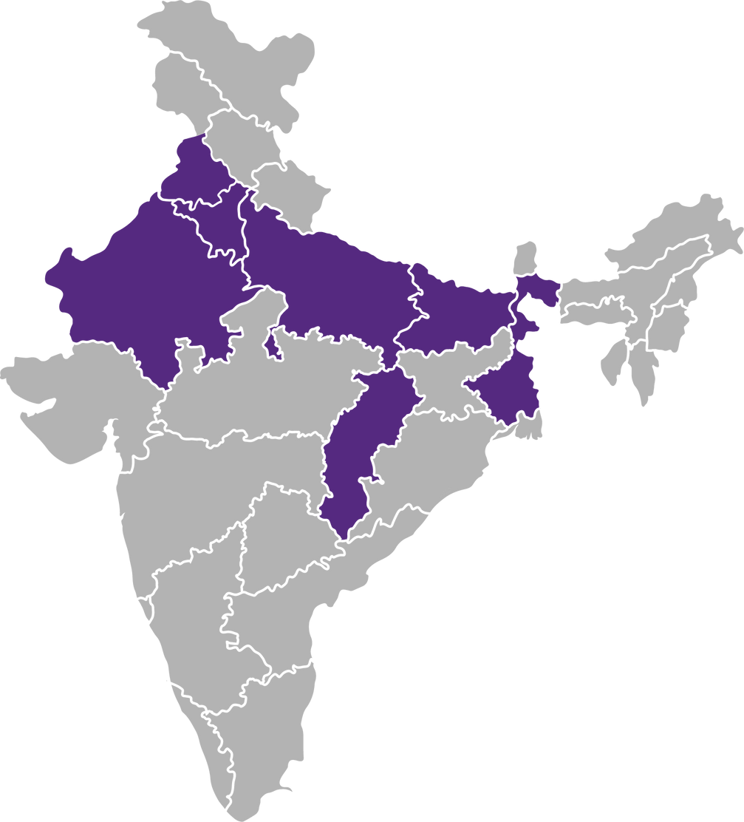
WAVECON
CHANDIGARH
DELHI
GURGAON
JAIPUR
LUCKNOW
PATNA
KOLKATA
RAIPUR

Slide 11
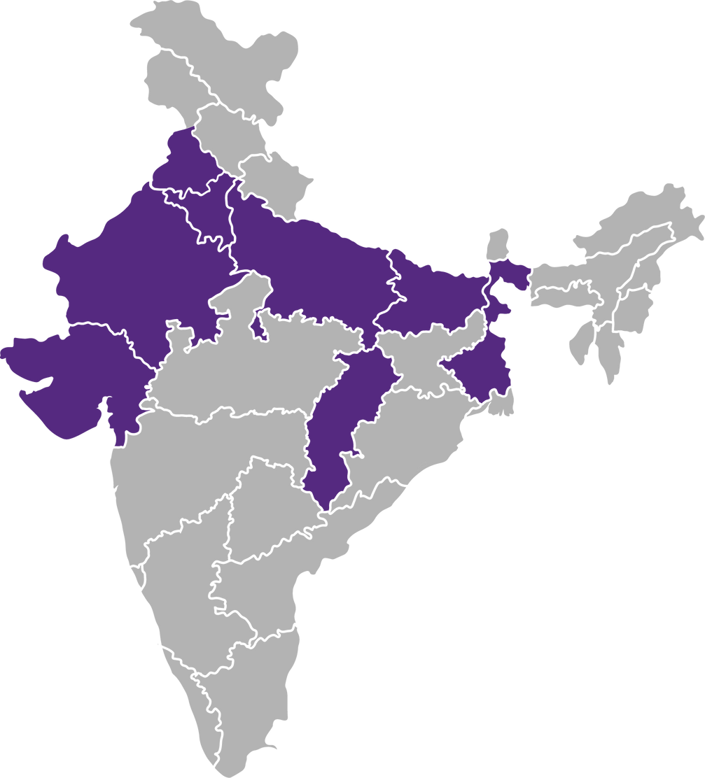
WAVECON
CHANDIGARH
AHMEDABAD
DELHI
GURGAON
JAIPUR
LUCKNOW
PATNA
KOLKATA
RAIPUR

Slide 12
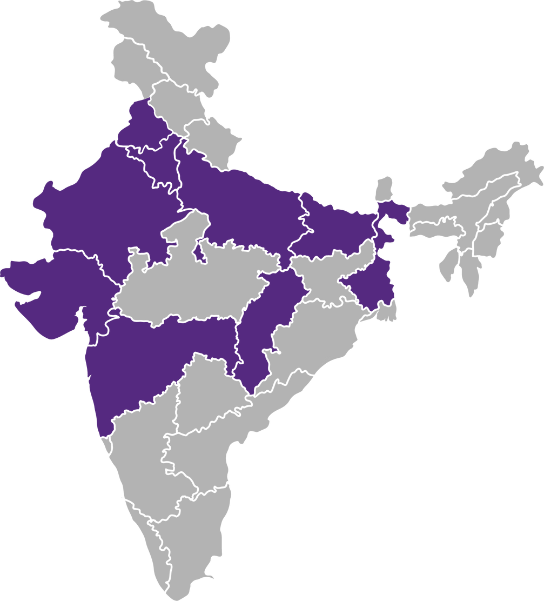
WAVECON
CHANDIGARH
AHMEDABAD
DELHI
MUMBAI
GURGAON
PUNE
JAIPUR
LUCKNOW
PATNA
KOLKATA
RAIPUR

Slide 13
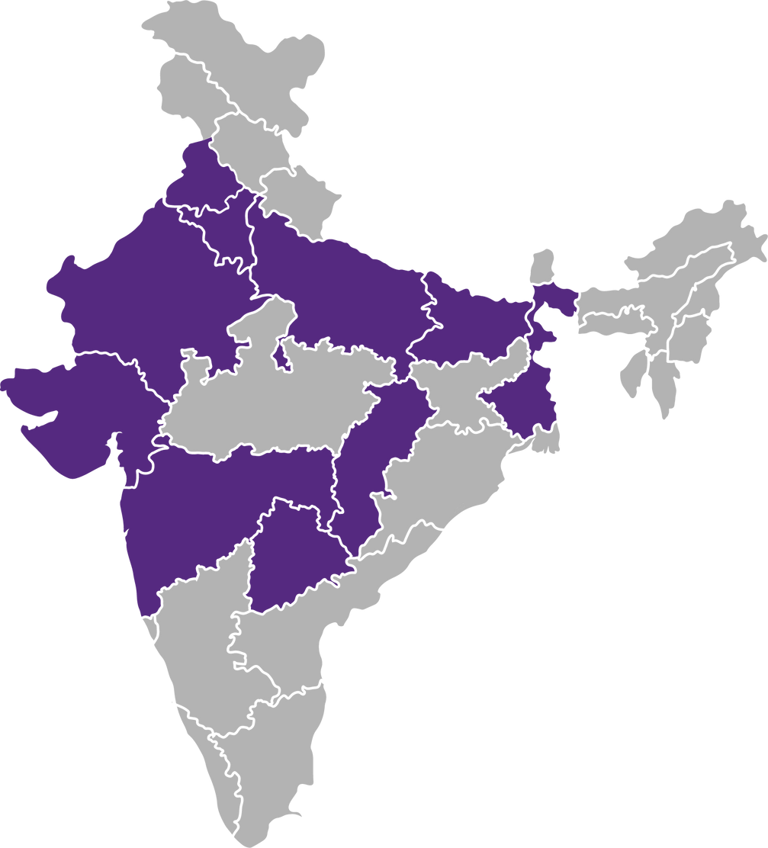
WAVECON
CHANDIGARH
AHMEDABAD
DELHI
MUMBAI
GURGAON
PUNE
JAIPUR
HYDERABAD
LUCKNOW
PATNA
KOLKATA
RAIPUR

Slide 14
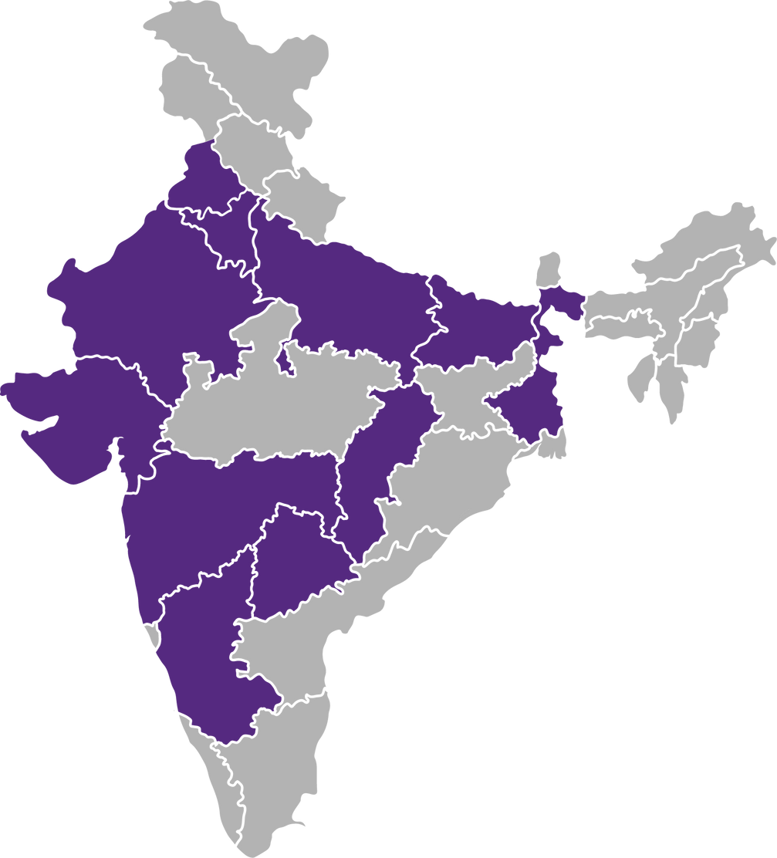
WAVECON
CHANDIGARH
AHMEDABAD
DELHI
MUMBAI
GURGAON
PUNE
JAIPUR
HYDERABAD
LUCKNOW
BANGALORE
PATNA
KOLKATA
RAIPUR

Slide 15
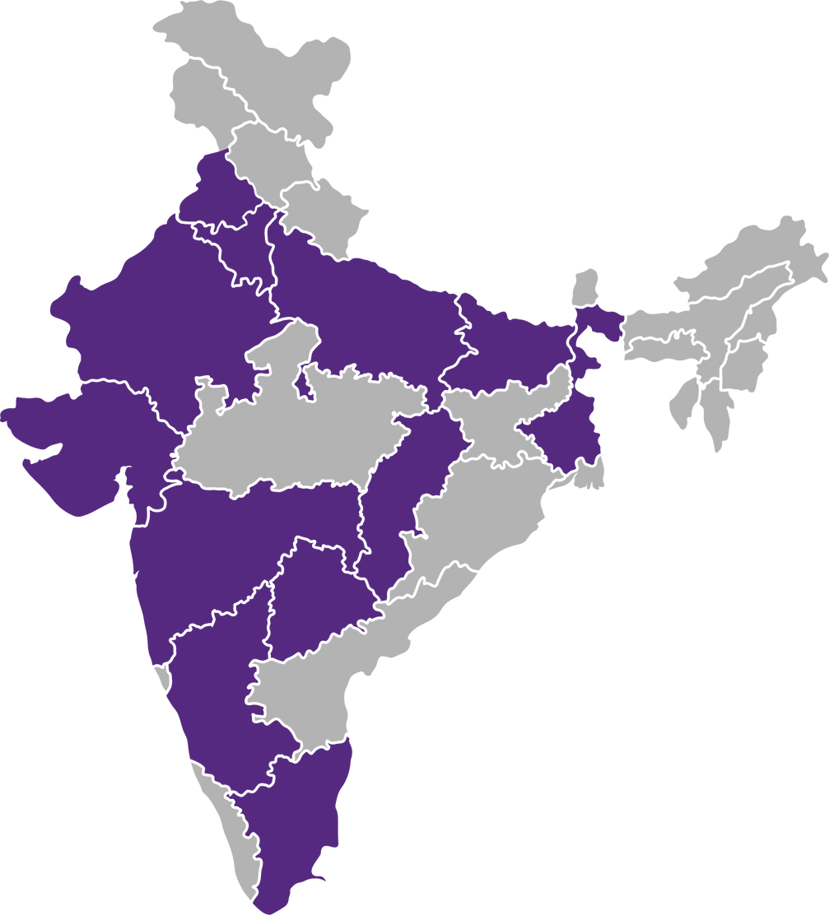
WAVECON
CHANDIGARH
AHMEDABAD
DELHI
MUMBAI
GURGAON
PUNE
JAIPUR
HYDERABAD
LUCKNOW
BANGALORE
PATNA
CHENNAI
KOLKATA
COIMBATORE
RAIPUR

Slide 16
WAVECON
What is the impact of the 5G launch on our revenue?
Which KPI is underperforming after the 5G launch?
After the 5G launch, which plans are performing well in terms of revenue?
Which plans are not performing well?
Is there any plan affected largely by the 5G launch?
Should we continue or discontinue that plan?
Is there any plan that is discontinued after the 5G launch?
What is the reason for it?

Slide 17
What is the impact of the 5G launch on our revenue?
Total Revenue
31,874 M
Revenue Before 5G
15,977 M
Revenue After 5G
15,897 M
Revenue Change
-80 M
Revenue Change %
-0.50 %

Slide 18
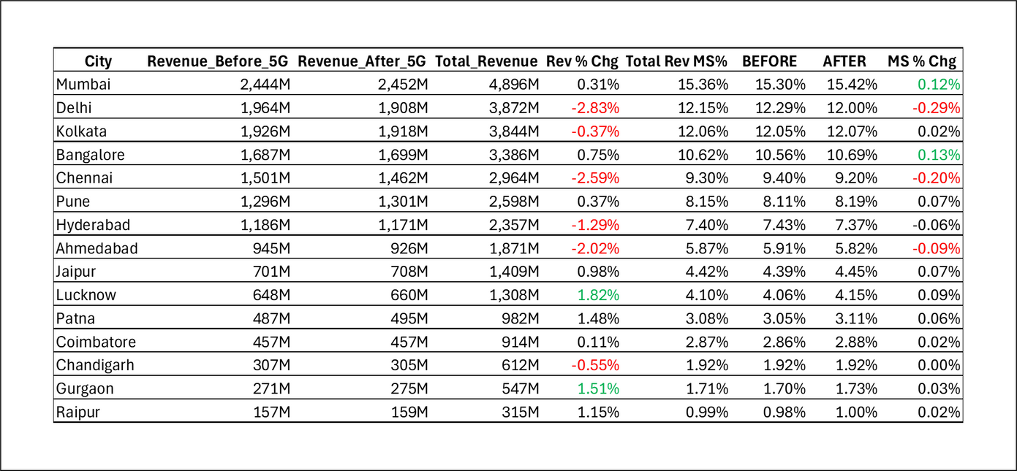
Key Highlights
Mumbai, Delhi, Kolkata, and Bangalore collectively account for 59.49% of total revenue, making them critical to the overall performance.
Delhi and Chennai show revenue declines of 0.29% and 0.20%, respectively. Given their significant revenue contribution, even a small percentage decrease can have a substantial impact on overall performance.
Cities like Patna, Lucknow, and Gurgaon exhibit positive revenue changes, with Lucknow leading at 1.82% growth.

Slide 19

Which KPI is underperforming after the 5G launch?
Revenue
- 0.50%
TAU - Total Active Users
- 8.28%
TUuS - Total Unsubscribed Users
23.50%

Slide 20
TAU - Total Active Users
- 8.28%
Key Highlights
There is a net loss of 69.83 million active users (-8.28%) post-5G launch.
The cities facing the highest loss in active users (both in absolute and percentage terms) are:
Delhi: -19.07 million (-17.63%)
Mumbai: -17.99 million (-14.35%)
Bangalore: -13.46 million (-13.94%)
Cities with Active User Growth:
Pune: 11.65 million new users (+18.06%) – a standout performance.
Lucknow: A smaller but positive growth of 0.84 million (+2.65%).

Slide 21
TUuS - Total Unsubscribed Users
23.50%
Key Highlights
The total number of unsubscribed users increased by 13.24 million (+23.50%) post-5G launch.
Cities with the Highest Increase in Unsubscribers:
Chennai: +1.91 million (+36.94%)
Delhi: +1.28 million (+16.62%)
Jaipur: +1.17 million (+52.47%) – the largest percentage increase.
Hyderabad: +1.47 million (+38.08%)
Cities with Decline in Unsubscribers:
Mumbai: A decline of -1.21 million (-12.63%) – a positive indicator of customer retention.

Slide 22
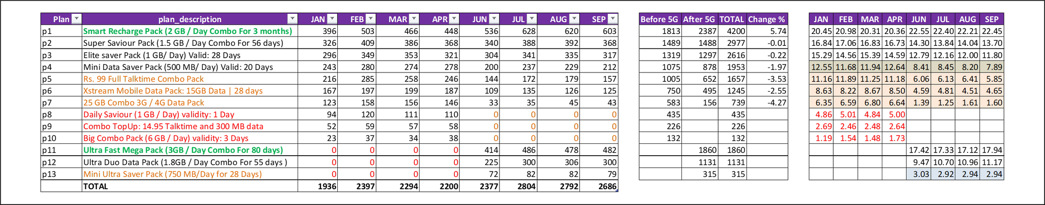

After the 5G launch, which plans are performing well in terms of revenue? Which plans are not performing well?
Plan Details
% Change
Market Share
*All the values are in Million
*Values are in Million & %
*All the values are in Percentage(%)
Plan P1, Maintains consistent growth, peaking at 22.55% in June and stabilizing above 22% through September. Generate 4200M.
This long-term plan provides significant value, making it the most attractive for customers post-5G.
Plan P11, Maintains steady performance with consistent market share (peaking at 17.94% in September). Generate 1860M.
High daily data allowance and reasonable validity make it popular among heavy data users.
Plan P12, Improved steadily, reaching 11.17% by September. Generate 1313M.
A mid-range data pack offering good value for moderate users, showing strong performance.

Slide 23

After the 5G launch, which plans are performing well in terms of revenue? Which plans are not performing well?
Plan Details
% Change
Market Share
*All the values are in Million
*Values are in Million & %
*All the values are in Percentage(%)
Plan P7, Steep decline, with share dropping below 2% from June onward. Customers are likely shifting away from limited 3G/4G plans as 5G becomes more dominant.
Plan P5, Declining steadily, down to 5.85% by September. The decline in talk time-based plans indicates a shift towards data-heavy usage patterns.
Plan P4, Fell from 12.55% in February to 7.89% in September. Limited data capacity makes it less appealing in the 5G era.

Slide 24

Is there any plan affected largely by the 5G launch? Should we continue or discontinue that plan?
Plan Details
% Change
Market Share
*All the values are in Million
*Values are in Million & %
*All the values are in Percentage(%)
Plan P7, Steep decline, with share dropping below 2% from June onward.
This plan has been significantly impacted post-5G as users migrate away from 3G/4G technology.
Customers are likely shifting away from limited 3G/4G plans as 5G becomes more dominant.
Should be replace it with a similar 5G-compatible plan offering higher data limits to attract migrating users.

Slide 25
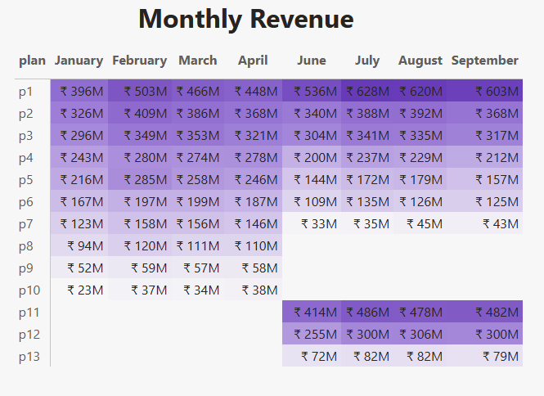
Is there any plan that is discontinued after the 5G launch? What is the reason for it?

Slide 26


Plan Details
% Change
Market Share
*All the values are in Million
*Values are in Million & %
*All the values are in Percentage(%)
Plan P8 - Daily Saviour Pack (1 GB/Day, 1-Day Validity)
Plan P9 - Combo TopUp (14.95 Talktime and 300 MB Data)
Plan P10 - Big Combo Pack (6 GB/Day Validity: 3 Days)
Key Drivers for Discontinuation
Plans with short validity (1-3 days) or low data allowances no longer align with the needs of 5G users
who demand higher data and longer validity.
The shift to 5G increased demand for plans offering greater value, longer-term stability, and higher data capacity.

Slide 27

Key Observations
Short Validity Plans Are Outdated:
Plans with very short durations (e.g., 1-3 days) no longer meet user demands in the 5G market, where customers prefer longer-term options for uninterrupted connectivity.
Low Data Plans Are Irrelevant:
Plans offering limited data, such as P8 (1 GB/Day for 1 Day) or P9 (300 MB Combo), fail to support the heavy data consumption needs brought by 5G.
Shift Towards Data-Driven Usage
Talktime-based plans like P9 are losing popularity as users prioritize high-speed data for streaming, gaming, and other online activities.
Preference for High-Value Plans
Long-term plans like P1 (2 GB/Day for 3 Months) and P11 (3 GB/Day for 80 Days) are performing well because they offer reliability and value for money.

Slide 28

Recommendations
Replace Discontinued Plans with Better Options.
Promote Popular Plans.
Introduce Tiered Plans for Different Users.
Help Users Transition.

Slide 29
Thank
you!

